Slide 1

COVID-19 DESCRIPTIVE ANALYSIS: INFORMATION AND IMPACT ON EMPLOYMENT
THE CONQUERORS
Casabal, Maezie L.
Castillo, Nielsen
Dimaandal, Lalaine
Manalo, Johnrey
Natanauan, Lee-Ann Joy A

Slide 2
INTRODUCTION
The COVID-19 epidemic has caused one of the biggest job crises since the Great Recession. The crisis has the potential to raise unemployment and widen inequities, both of which will have long-term implications.
Many Americans were affected more than others as the COVID-19 issue spread throughout the economy.

Slide 3
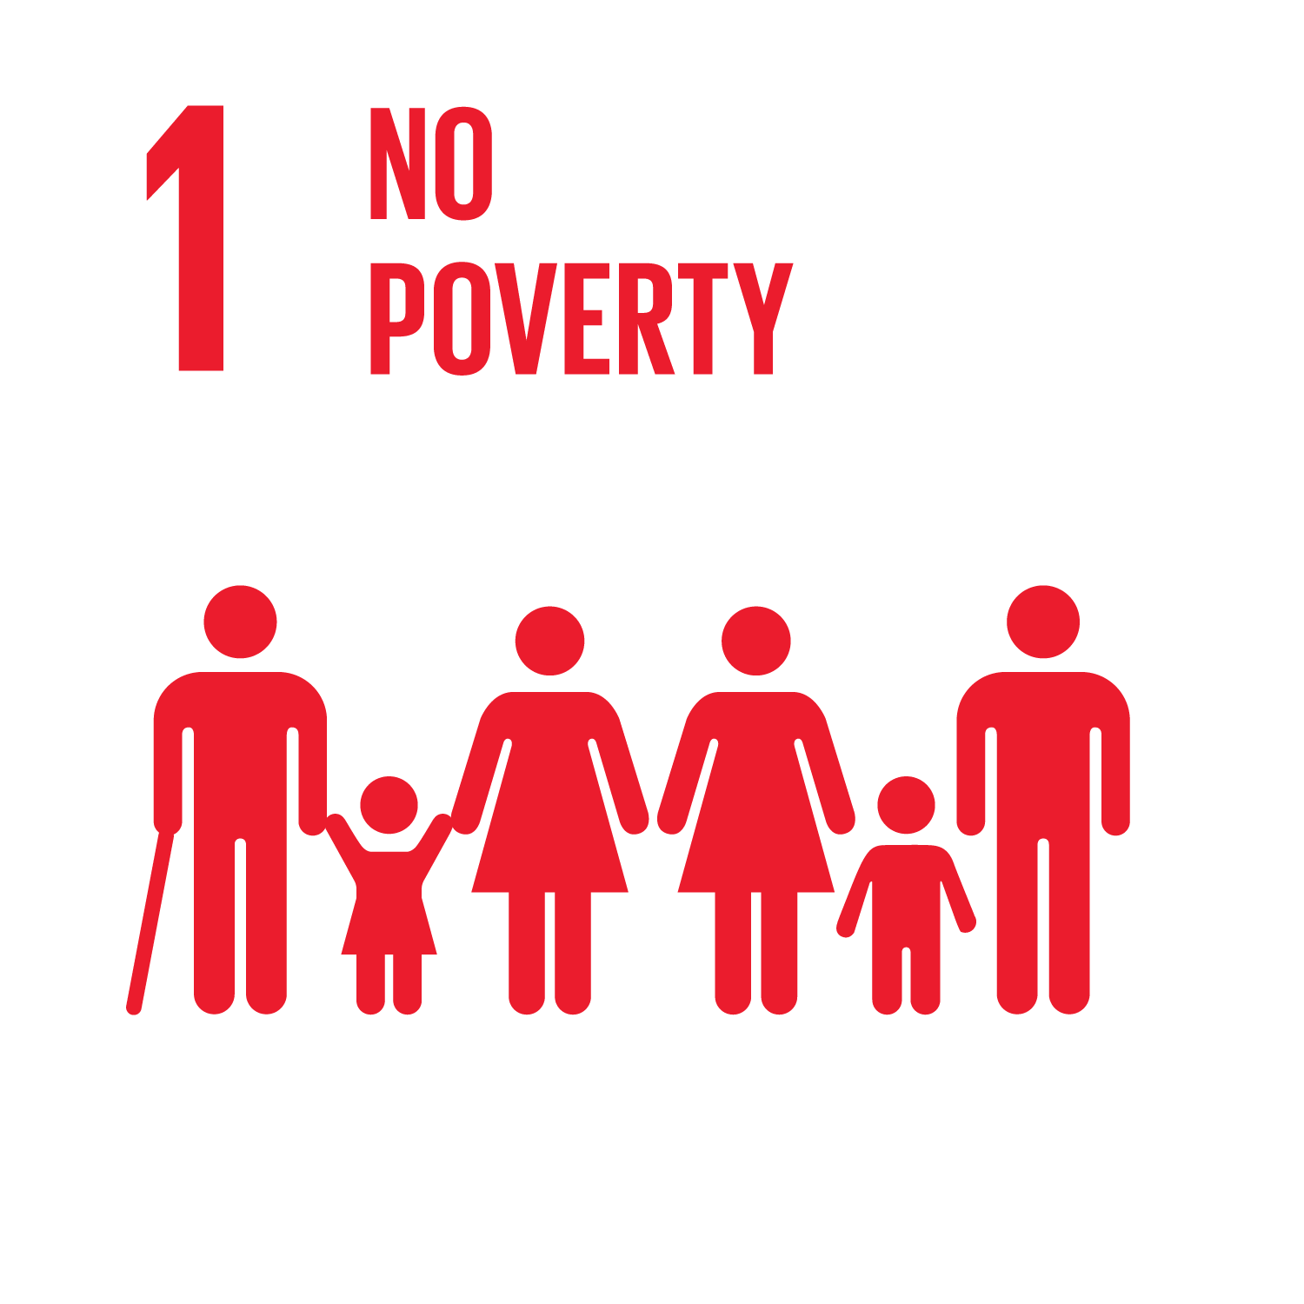

SUSTAINABLE DEVELOPMENT GOALS

Slide 4
STATEMENT OF THE PROBLEM
This pandemic problem have a big impact specially to workers who have family that need money to live and eat every day. In addition it also cause health problems like depression and stress due to overthinking how would they face the challenges everyday.

Slide 5
SIGNIFICANCE OF THE PROJECT
The given data would guide citizens of the US, particularly job workers, to have a deeper understanding about this study and for them to know what the things to do are in times of unemployment.

Slide 6
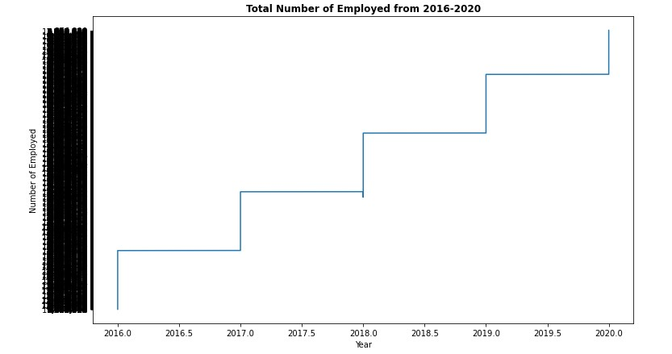
UNITED STATES EMPLOYED DURING 2016-2020

Slide 7
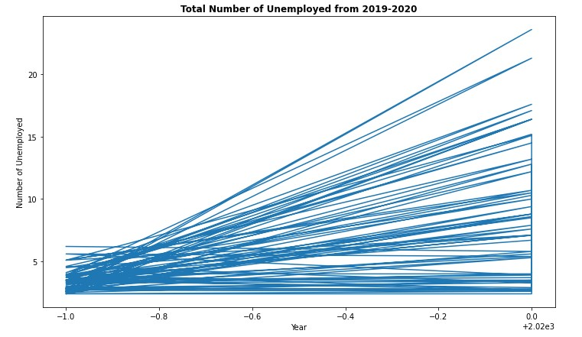
UNITED STATES UNEMPLOYED DURING PANDEMIC

Slide 8
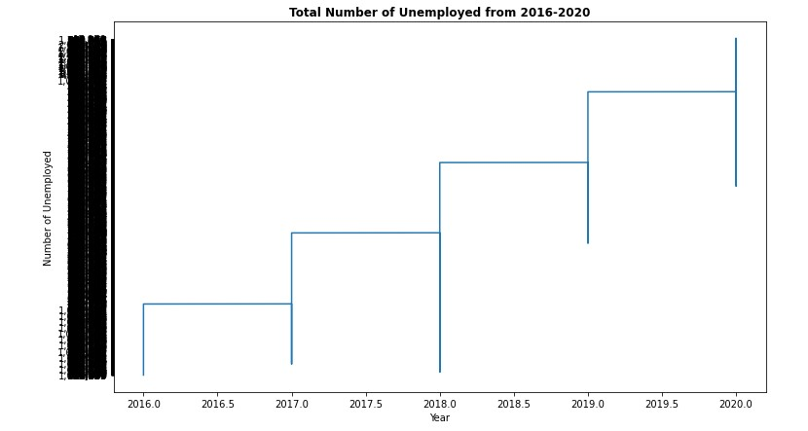
COMPARISONS OF UNEMPLOYED PEOPLE

